Slide 1
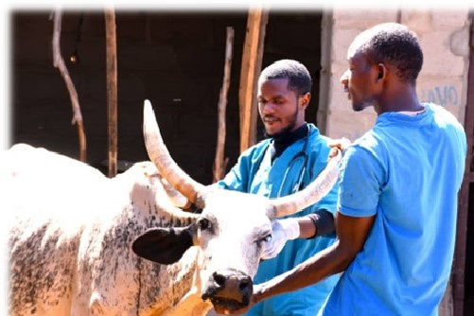



MODULE TWO
INTRODUCTION TO DISEASE SURVEILLANCE

Slide 2


SURVEILLANCE

Slide 3

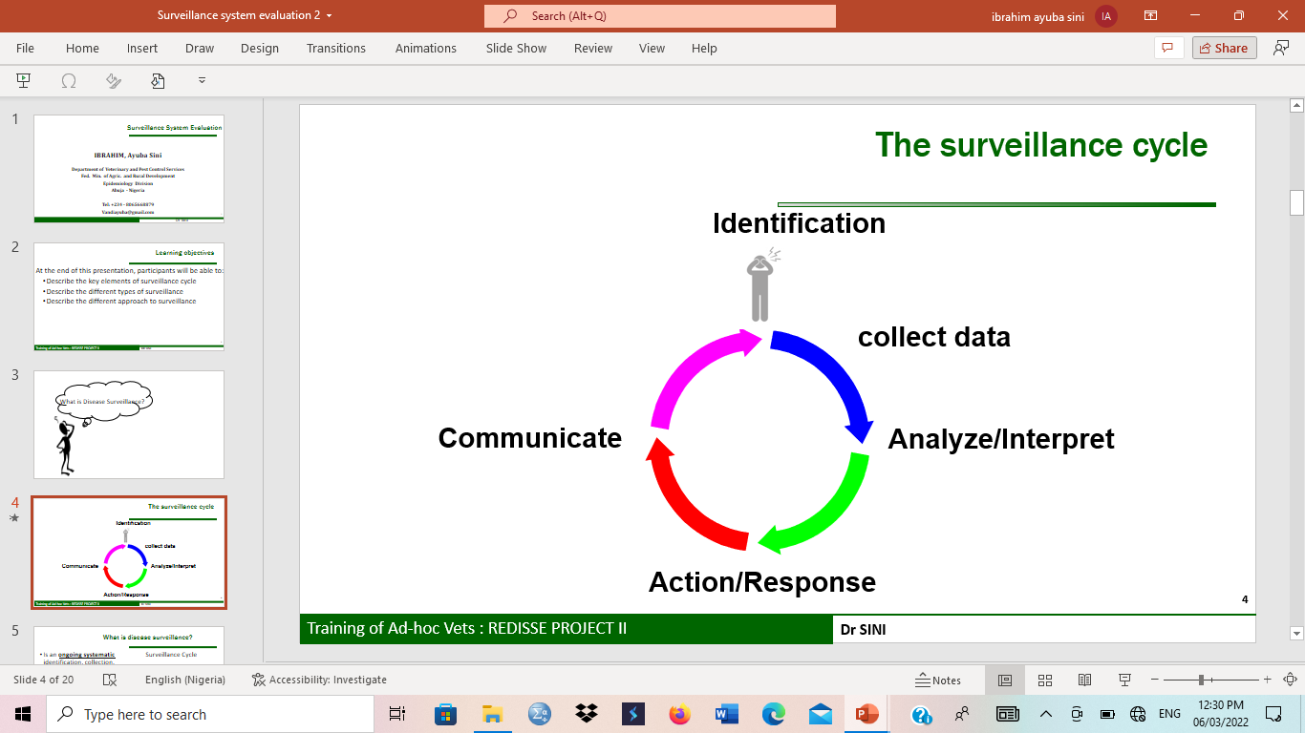
WHAT IS DISEASE SURVEILLANCE?

Slide 4

IMPORTANCE OF DISEASE SURVEILLANCE
To detect disease outbreaks.
To estimate the burden of disease
To identify areas/populations at high risk
To monitor trends and patterns of disease distribution
To evaluate control measures
To determine current disease status of an area
For planning and research purpose

Slide 5
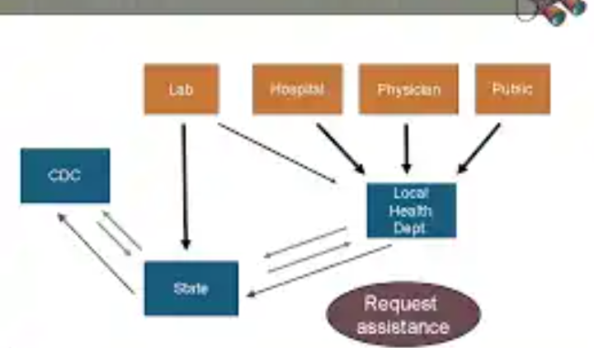
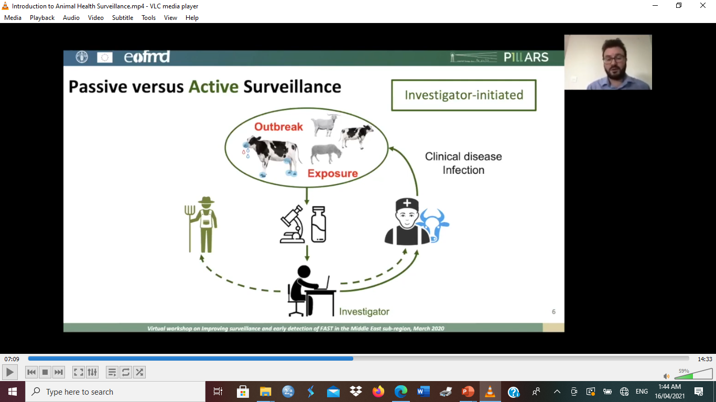

TYPES OF SURVEILLANCE
PASSIVE SURVEILLANCE
ACTIVE Surveillance

Slide 6


EXPERIENCE SHARING
Passive Surveillance
Active Surveillance

Slide 7

SURVEILLANCE POINTS
  Abattoir / Slaughter slaps
  Livestock/Poultry Farms
  Hatcheries
  Live bird markets/Livestock Market
  Wetlands
  Zoo / Wildlife game reserve
  Interstate or International control post
  Clinics / hospitals
  Laboratories
  PHC
  Pharmaceutical stores
  Immunization centers

Slide 8


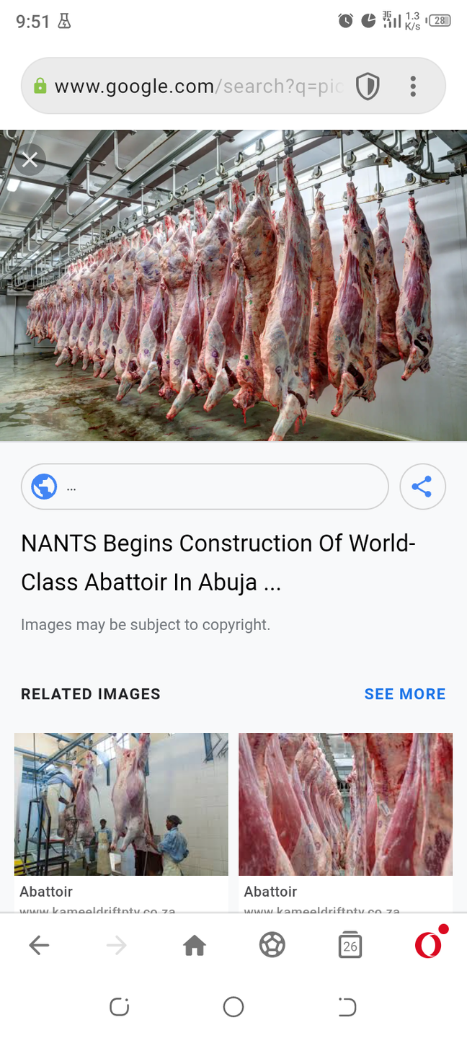



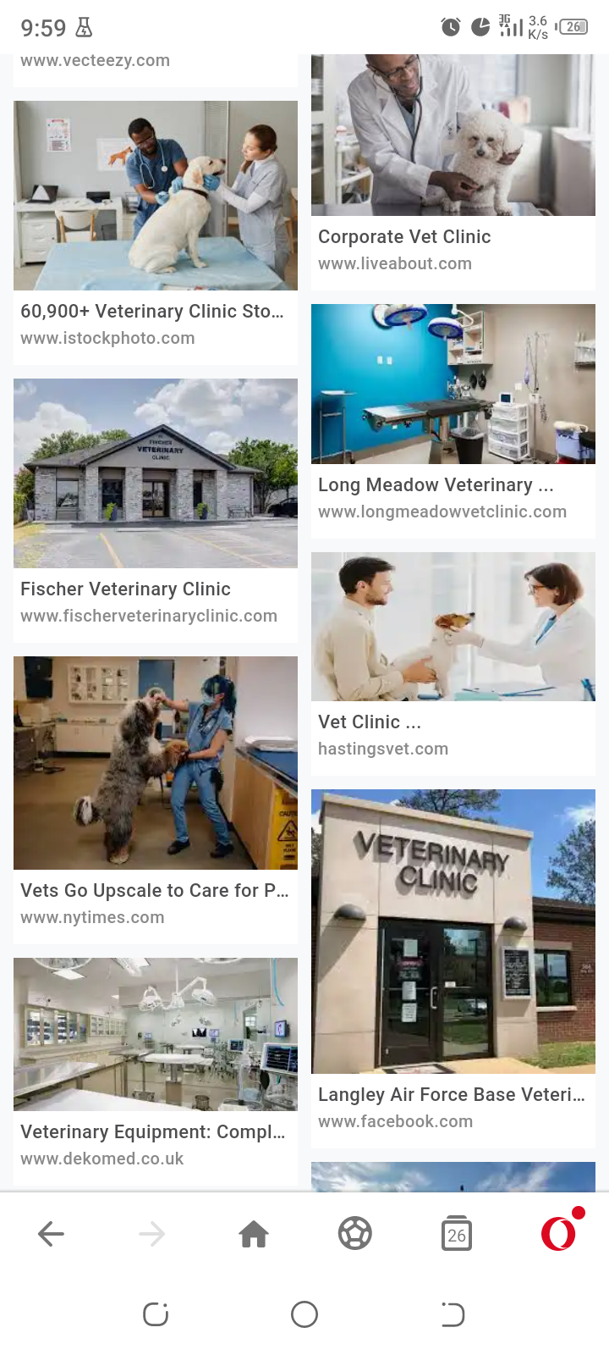
SURVEILLANCE POINTS

Slide 9

EPIDEMIO-SURVEILLANCE NETWORK
Federal Vet.Service – Hqtrs and Field offices (37)
State Veterinary Services
774 Area Vet. Offices in each LGA
591 surveillance points (Livestock markets, Abattoirs, Control posts, Veterinary clinics)
Laboratory Network
  National Veterinary Research Institute (NVRI)
  Private Laboratories
  Universities – VTHs
Local Govt Agric. Departments

Slide 10
EPIDEMIO-SURVEILLANCE NETWORK
Federal Ministry of Health – Hqtrs and State offices (37)
State Ministry of Health (State DSNO)
774 LGAs DSNO
774 LGAs Health Departments
Over 34,000 PHC

Slide 11

VETERINARY LABORATORY NETWORK
NVRI is a BSL 3 and is the only national reference laboratory for animal diseases
NVRI (+ 23 outstation labs)
11 VTHs
Private Labs (not updated)

Slide 12
MEDICAL LABORATORY NETWORK
National Centre for Disease Control Laboratories
36 + FCT States Laboratories (Tertiary, Secondary, Primary)
University Teaching Hospitals Laboratories
Private Laboratories

Slide 13


Simplicity
Flexibility
FEATURES OF A GOOD SURVEILLANCE SYSTEM
Acceptability / Ownership
Sensitivity
Representativeness
Timeliness and Resources

Slide 14


END OF MODULE 2

